Slide 1
C++ based Bank Application Systems
Developer
Michael Stanley chinaza

Slide 2
Objectives
Introduction.
Aims and Benefits.
Requirements
Problem Description.
Architecture/Solution Design.
Data structures used.
Implementation Code output Screenshot.
Conclusion.

Slide 3
Introduction
The bank C++ app is an application for maintaining a person's account in a bank. The system provides the access to the customer to create an account, deposit/withdraw the cash from his or her account, also to view reports of all accounts present.

Slide 4
Aims and benefits
To develop a software for solving financial application fo a customer in banking environment in order to nurture the needs of an end banking user by providing various ways to perform banking tasks. Also to enable the user’s workspace to have additional functionalities which are not provided under a conventional banking software.

Slide 5
Requirements
Functional Requirements
Non-functional Requirements
User requirements
System requirements

Slide 6
Functional requirements
User basic graphical tools such as shapes, objects, brushes, colour tools, eraser e.t.c
Should allow free hand drawing, object shapes such as circle, ellipse, rectangle, polygon.
Should allow the usage of different colours in the form of brushes, shapes, curves.
Manage the picture with tools such as pencil, airbrush, clear all

Slide 7
Non- Functional Requirements
Must provide the program in vivid colours and format.
Should have adaptability to allow usage of single module at a time.
Must enable faster processing of operation when a module is selected.
Must be a full detailed application.

Slide 8
User Requirement
Dev C++ or Visual studio code and other supported C++ compiler.
Front end : C++

Slide 9
System requirements
Hardware
Pentium IV processor
Ram 512MB
HDD or SSD capacity 2GB
Intel graphics

Slide 10
Problem description
At recent times, people leave their homes to the bank in search of many bank activities, like check account balance deposit, withdraw, transfers, cash collections and loan collections. Sometimes this causes too many crowd at the bank making people to lose their other day to day activities and some risk of getting robbed. Most at times there are some people with busy schedule that doesn't have much time to go to the bank to make transaction every day! So a fix for all this will be a bank application to make it easier and comfortable for everyone anywhere.

Slide 11
Architecture / Solution Design
For me to get a perfect solution and face the above problem, i will explain the use of every feature present in this application. I will also give an architectural design on how it works. Let's explain every feature in the app.. Next slide

Slide 12
Modules
Features Description
Create file | Selecting this create a new file for the user by accepting input such as account number, name and amount a start.
Open an account | Open a new account for the user by accepting inputs such as account number, name and minimum balance for a start
Search | Enables to search for the details of the given account number. Displays only one account detail at a time
Deposit | Provides options to deposit amount from the given account number!

Slide 13
Modules
Features Description
Withdraw | This feature provides partitions for withdraw any amount from the given account number.
Cancel account/delete account | Cancel the selected account from the bank
Report | Displays the list of all account details comprising of account detail comprising of account number, name and balance amount

Slide 14
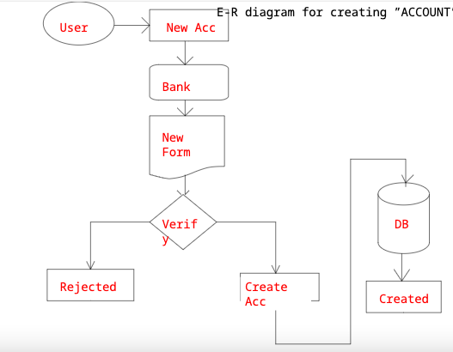
E.R Diagram

Slide 15
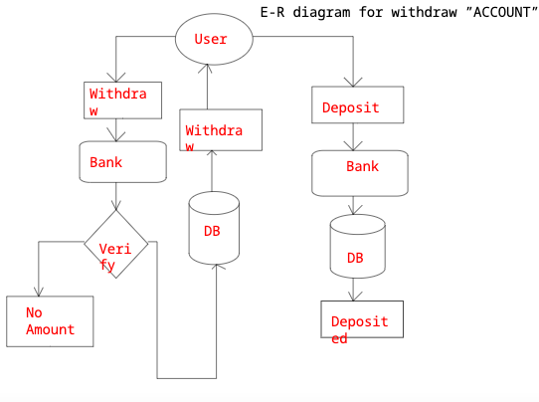
E.R Diagram

Slide 16
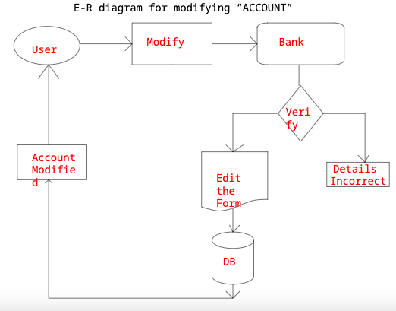
E.R Diagram

Slide 17
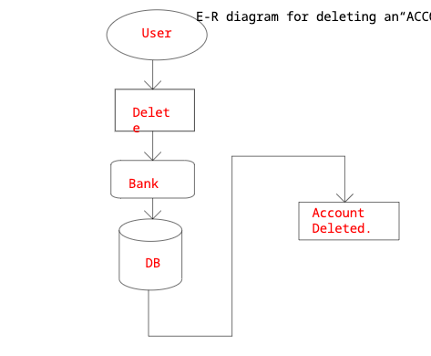
E.R Diagram

Slide 18
Data structures used
Queue
Stacks
Linked-list
Tree [Binary search Tree]

Slide 19
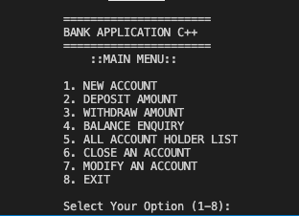
Implementation Code Output Screenshot

Slide 20
Conclusion
This project is developed to nurture the needs of a user in a banking sector by embedding all the tasks of banking transactions. The future version of the software will still be as much enhanced that the current version 1.0. Thus the bank application is developed and executed successfully.

